Slide 1
Cloud Native Applications
By Arsalan Nawaz Khan

Slide 2
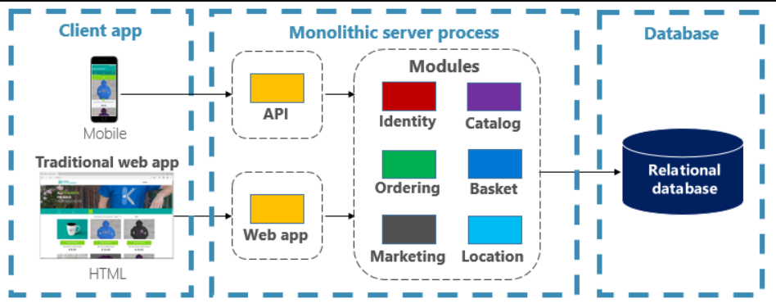
Traditional Monolithic Applications
Notes:
15 years ago if we were asked to design an ecommerce site we would have used the traditional monolithic architecture2
You construct a large core application containing all of your domain logic. It includes modules such as Identity, Catalog, Ordering, and more. The core app communicates with a large relational database. The core exposes functionality via an HTML interface.
Not all is bad. Monoliths offer some distinct advantages. For example, they're straightforward to “Build, test, deploy, troubleshoot”

Slide 3
Problems with Monolithic approach
Application becomes complicated over a certain time period
Each change can lead to unintended and costly side effects and become time consuming
Each release requires a full deployment of the entire application.
One unstable component can crash the entire system.
Notes:
The app has become so overwhelmingly complicated that no single person understands it.
You fear making changes - each change has unintended and costly side effects.
New features/fixes become tricky, time-consuming, and expensive to implement.
Each release as small as possible and requires a full deployment of the entire application.
One unstable component can crash the entire system.

Slide 4
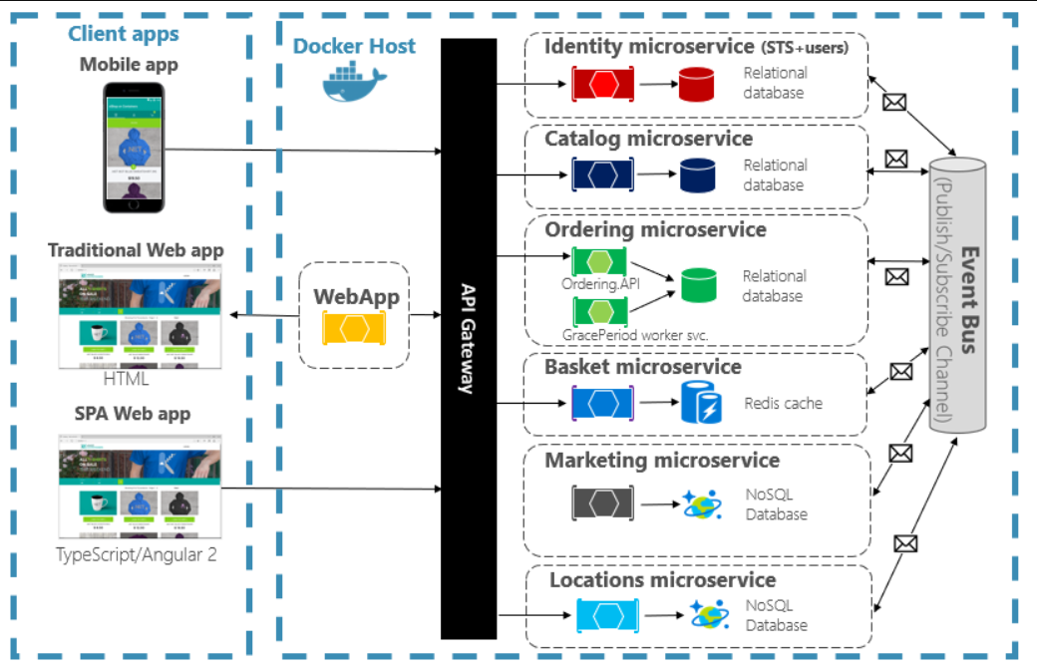
Cloud Native Approach
Notes:
The same application if designed using the cloud native approach would be designed we separate out the entire application into smaller sets of isolated microservices
Each service is self-contained and encapsulates its own code, data, and dependencies.
All the traffic is routed through a gateway which would be used as a single point of interaction between client and backend which can help us ensure the security

Slide 5
What are Cloud Native Applications?
One of the definitions is
Cloud-native applications are a collection of small, independent, and loosely coupled services. They are designed to deliver well-recognized business value, like the ability to rapidly incorporate user feedback for continuous improvement.
Simply this means Cloud-native development is just an approach to build scalable and fault tolerant apps quickly
Notes:
In short, cloud-native app development is a way to speed up how you build new applications, optimize existing ones, and connect them all. Its goal is to deliver applications at the pace a business needs.

Slide 6
Cloud Native Application components and tools
Microservices
Discovery Service (eg Eureka)
Api Gateway (eg Zuul, Spring Cloud Gateway, Ocelot)
Log analytics (eg ELK Stack, Splunk)
Distributed Tracing (eg Sleuth, Zipkin)
Actuators
Notes:
We will be discussing the following components Microservices, …. I have prepared a sample application utilizing all these components that I will demo as well

Slide 7
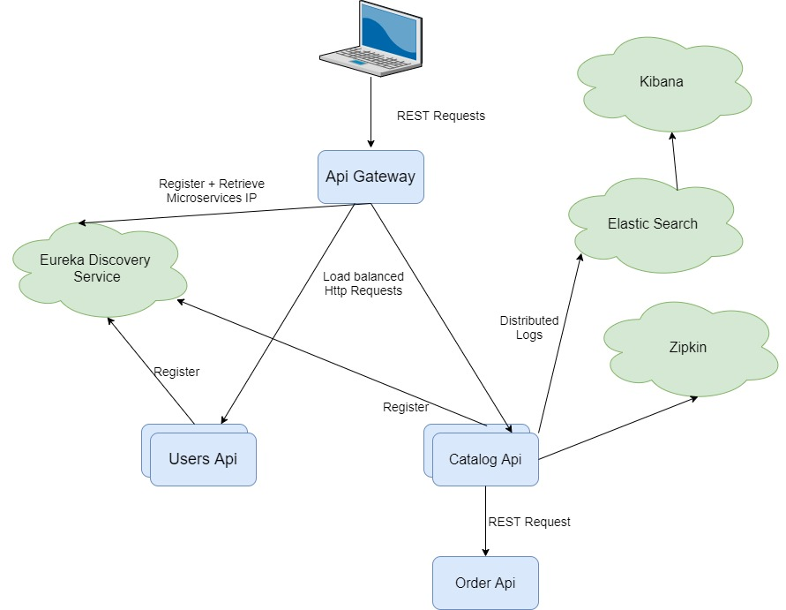
Application Architecture

Slide 8
Microservices
Used for designing and developing an application as a suite of small services, each running in its own process
Have a bounded context
They are Independently deployable
Notes:
Most of you already are aware of microservices so I will make this brief
microservice is an architectural style is an approach to developing a single application as a suite of small services, each running in its own process.
Each microservice is confined within a bounded context which means that each microservice has a boundary around which the whole microservice needs to be built. Eg products microservice
Will have only things related to products will be added in the microservice
These services are built around business capabilities and independently deployable

Slide 9
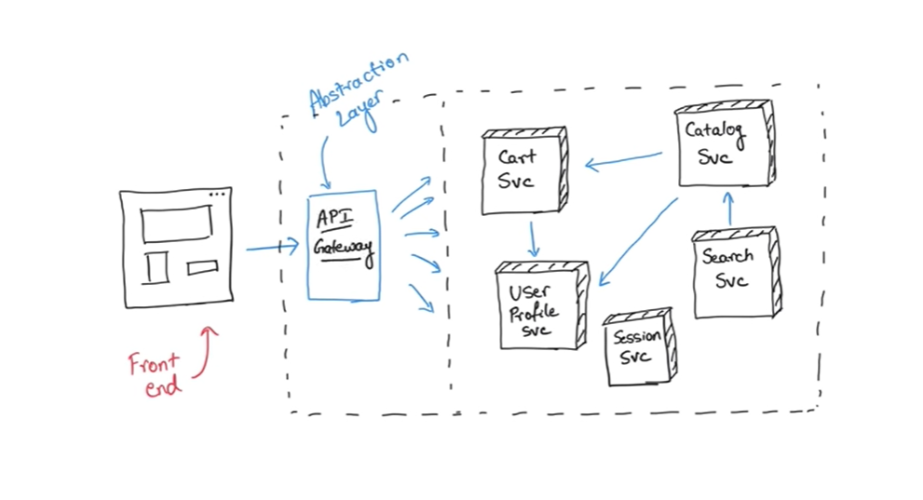
Api Gateway
Single entry point
Abstraction layer
Router
Monitoring requests
Security
Notes:
An API Gateway is a server that is the single entry point into the system
It is nothing more than an abstraction layer provided between the client and all the microservices
It will act as a router to all the incoming requests and send them to their respective microservices respectively
One of the uses of api gateway is that it can provide us the ability to monitor all the requests i.e. to measure how many requests are coming in how long they are taking to process etc
You add authentication on this layer which can act as a security layer between our system and the outside world handling Denial of Service Attacks restricting certain users, ip etc
Eg Zuul by Netflix, Spring Cloud Gateway, Ocelot etc

Slide 10
Discovery Service
What is service discovery?
What is service registry?
Types of service discovery
Client side service discovery
Server side service discovery
Notes:
In a microservices application, the set of running service instances changes dynamically. Instances have dynamically assigned network locations. Consequently, in order for a client to make a request to a service it must use a service‑discovery mechanism.
A key part of service discovery is the service registry. The service registry is a database of available service instances.
There are two main service‑discovery patterns: client-side discovery and service-side discovery.

Slide 11
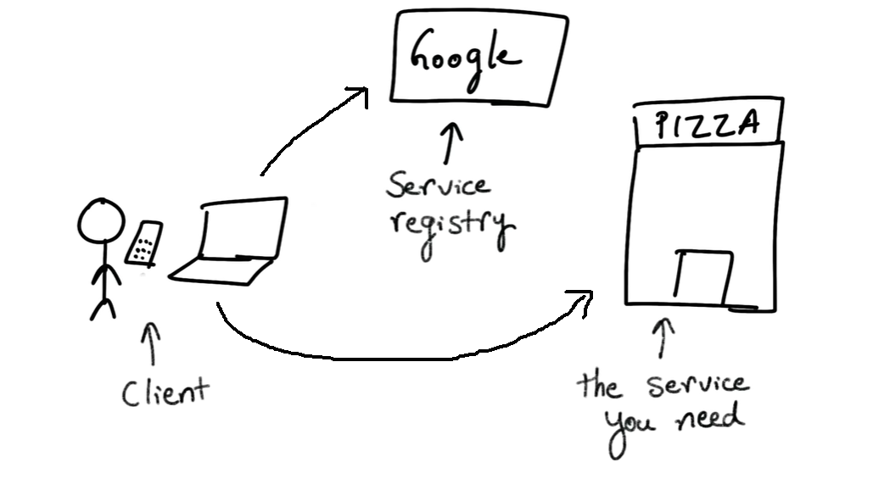
Client side service discovery
Notes:
Consider a scenario where a person would want to find a pizza place he would search on google the phone number of the pizza place and then call the pizza place using that phone number
Here google would act as the service registry as it has all the pizza places numbers.
The client is making 2 calls one to the service registry for the location and then to the actual service which in this case is the pizza place

Slide 12
Server side service discovery
Notes:
In systems that use server‑side discovery, clients make requests via a router, which queries the service registry and forwards the request to an available instance.
Consider a scenario where a person wants to call someone at some office but he only has his office’s number. He will call the office and the call will be received by the receptionist he will explain
Who he wants to contact to and the receptionist will be forward the call to the desired person. This is server side discovery in which the client has no idea of the service’s actual location so will contact the router which will forward it to the desired service

Slide 13
Actuators
There are certain endpoints that can be exposed with a microservice to monitor and manage a microservice eg of these are the health, metrics, httptrace etc
For spring boot actuator endpoints see here
For steeltoe actuator endpoints see here
Notes:
Spring boot is one of the tools for creating cloud native application in java and it provides these production ready endpoints
Steel toe is a .net open source library which also provides these production ready endpoints
Demo

Slide 14
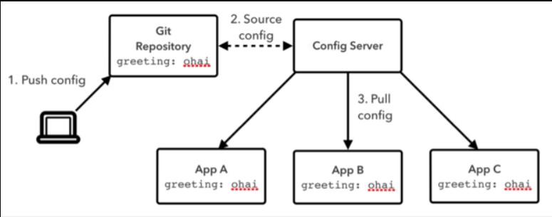
Config Server
Config Server is an externalized application configuration service
Centralized location to manage all the external properties
Notes:
Consider a scenario if one of the applications configuration variables is changed we would have to re deploy that application
Now consider 100 of microservices that are deployed it will become tedious to deploy all those microservices again
Config Server is an externalized application configuration service, which gives you a central place to manage an app’s external properties across all environments. As an app moves through the deployment pipeline from development to test and into production, you can use Config Server to manage the configuration between environments
One example of Config Server is the Spring Cloud Config Server
This config server provides a backend to git and serve configurations stored in the git repository.
The main advantage of using a config server would be that would not have to rebuild and redeploy all the microservices whenever a configuration is changed

Slide 15
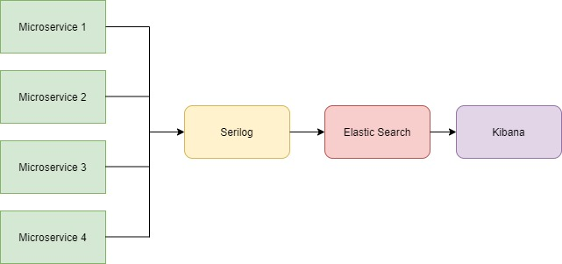
Log Analytics
Notes:
For trouble shooting and analysing logs in a distributed system is hard for this reason we need a capability to search for these logs in a singular location and quickly. For this reason we can
Use the ELK Stack which is a combination of Elastic Search, Logstash and Kibana. I am using serilog here instead of logstash which will send all the log data to the elastic search database to be indexed.
Elastic search is a full text search engine
Kibana is an free and open frontend application that sits on top of the Elastic Stack, providing search and data visualization capabilities for data indexed in Elasticsearch

Slide 16

Distributed Tracing using Sleuth and Zipkin
Notes:
In a distributed environment we can have multiple microservices that are communicating with one another.
We should be able to find which request is taking longer in which microservice to work on it and fix the problem
Spring Cloud Sleuth is meant to help with this exact problem. It introduces unique IDs to your logging which are consistent between microservice calls which makes it possible to find how a single request travels from one microservice to the next.
Spring Cloud Sleuth adds two types of IDs to your logging, one called a trace ID and the other called a span ID. The span ID represents a basic unit of work, for example sending an HTTP request. The trace ID contains a set of span IDs, forming a tree-like structure. The trace ID will remain the same as one microservice calls the next. Let's take a look at a simple example which uses Spring Cloud Sleuth to trace a request.
Zipkin is used for visual representation of the tracing data by utilizing the unique ids created by sleuth

Slide 17
Circuit Breaker Pattern
Microservice 1
Microservice 2
Microservice 3
Success
Failure

Slide 18
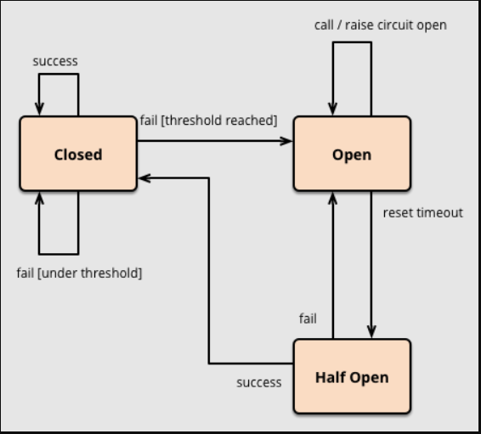
Circuit Breaker Pattern
Notes:
As in electrical components circuit breakers basic purpose is to interrupt current flow after a fault is detected to protect cascading components similarly in the distributed systems
This pattern follows the same concept it interrupts the current flow of request if a fault is detected which in return keeps our application from erroring out
3 states closed means business as usual
But if there are failures start occurring and they cross the threshold of acceptable failures then it will goto open state
After some time the system will try again by sending a few requests to faulty microservice this is called half open state
If the requests are successful the circuit will be closed again otherwise it will remain open

